Slide 1
Topics for today
t.b. completed

Slide 2
Machine learning
Machine Learning is like sex in high school. Everyone is talking about it, a few know what to do, and only your teacher is doing it

Slide 3
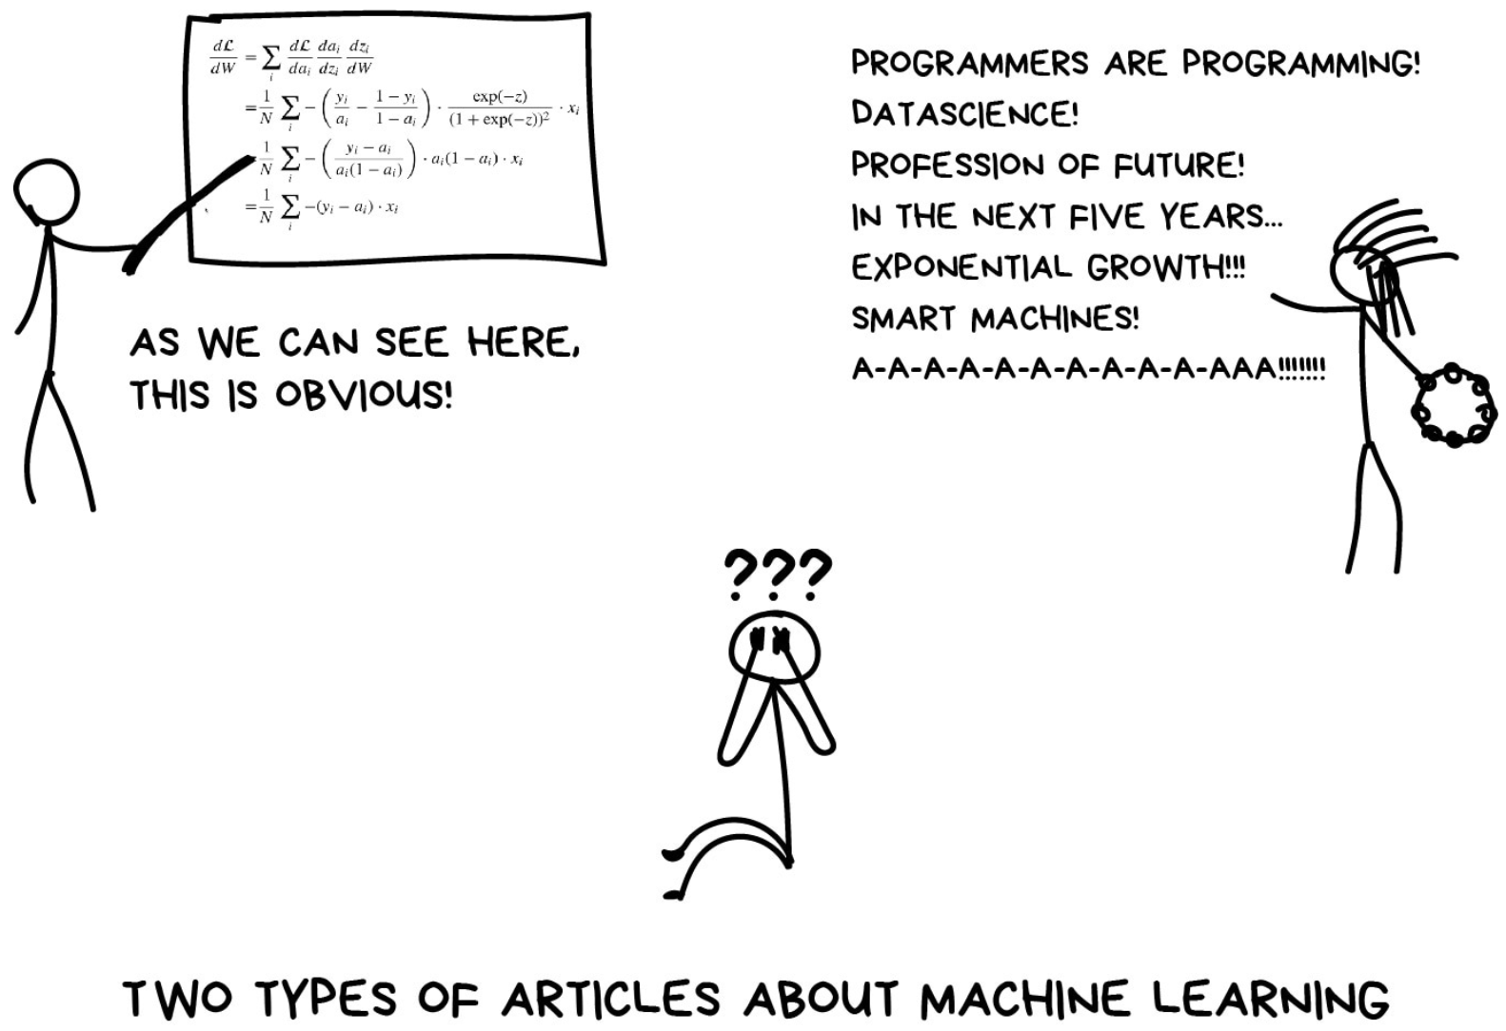
Source: Va3k.com

Slide 4
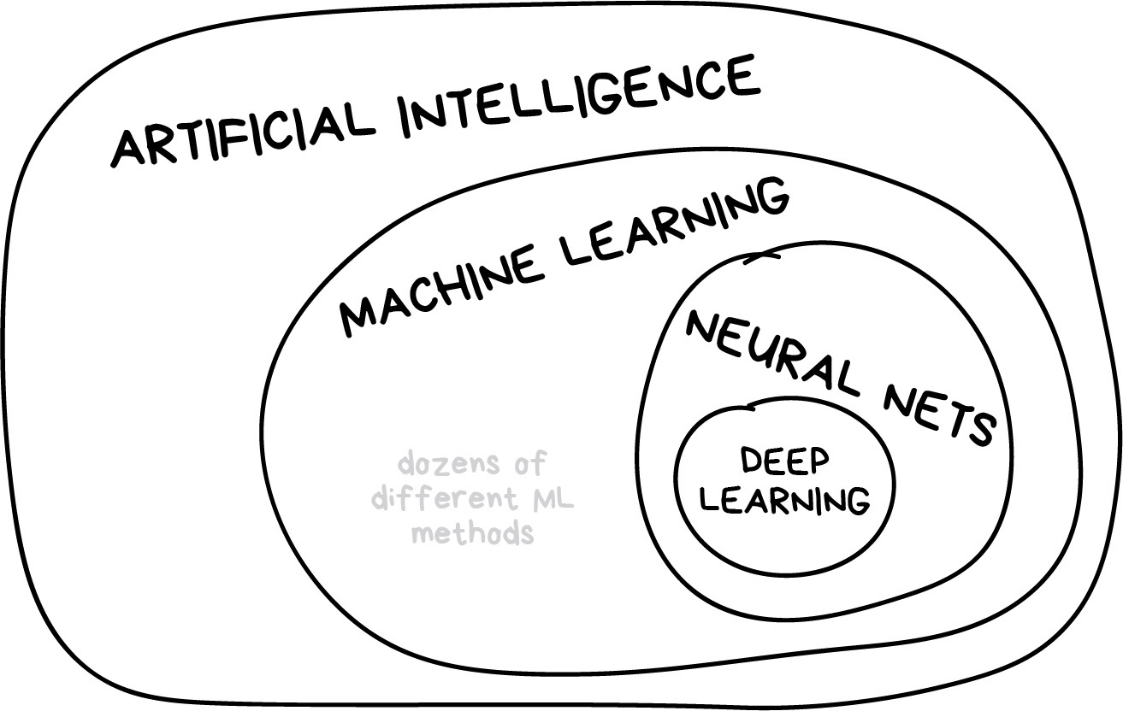
Learning vs Intelligence

Slide 5
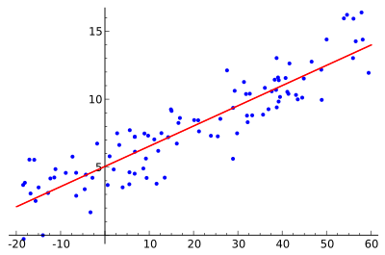
What is ML?
ML is nothing but a geomtry problem

Slide 6
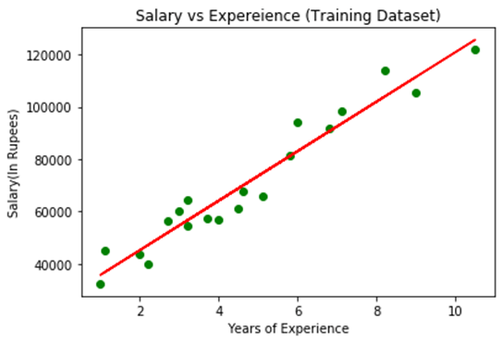
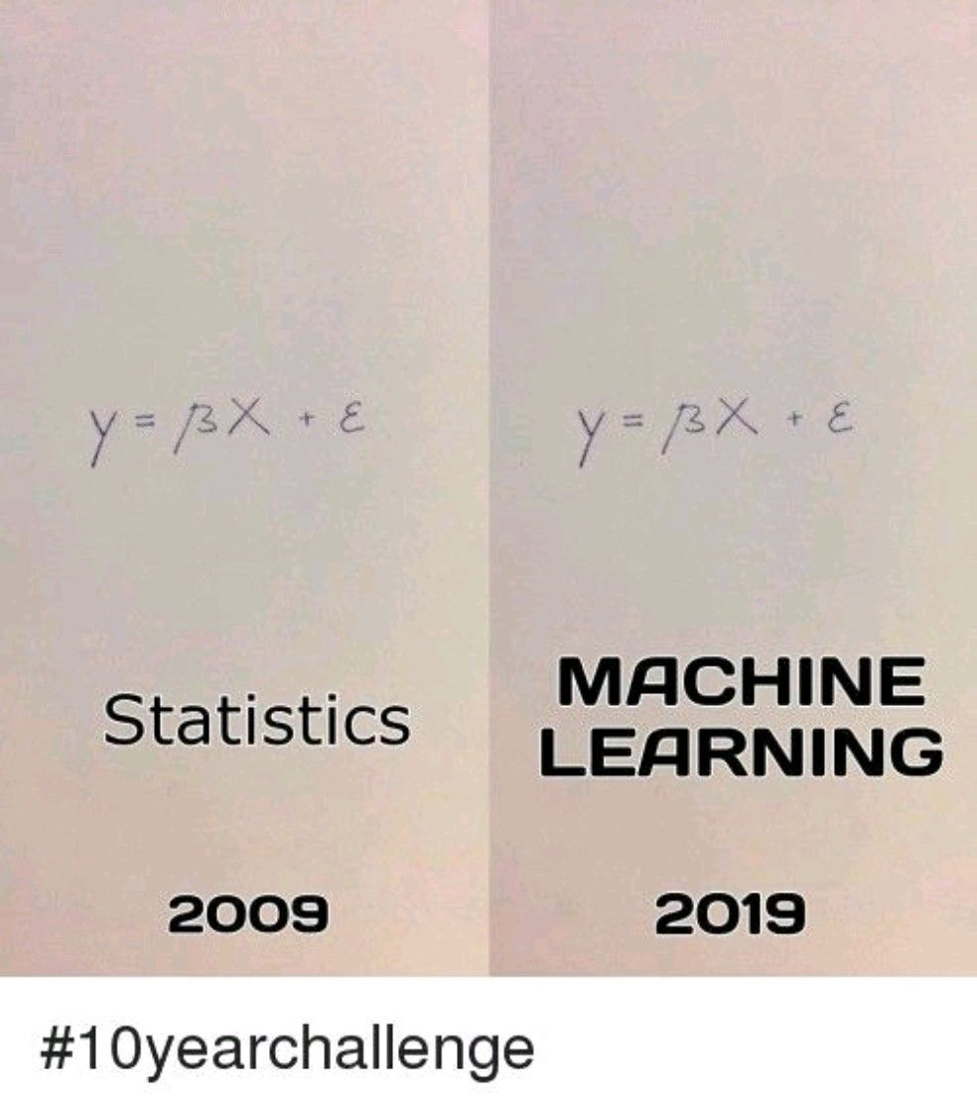
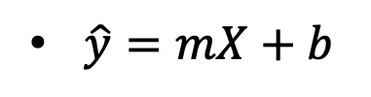
Example: Regression
Fit a line or curve
This is why old statisticians say: “ML is just glorified curve-fitting”
$\hat{y}=mX+b$

Slide 7
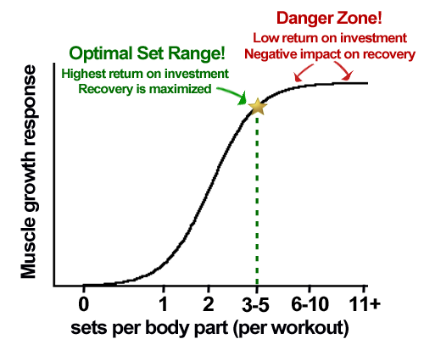
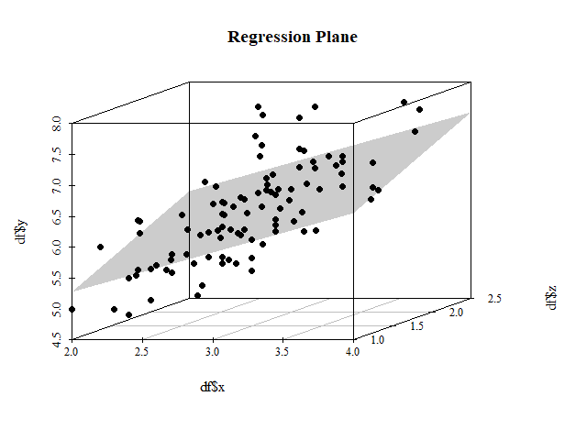
Why we use it
Compliated problems:
Have more input features (level of education, country, etc.)
Make targets non-linear

Slide 8
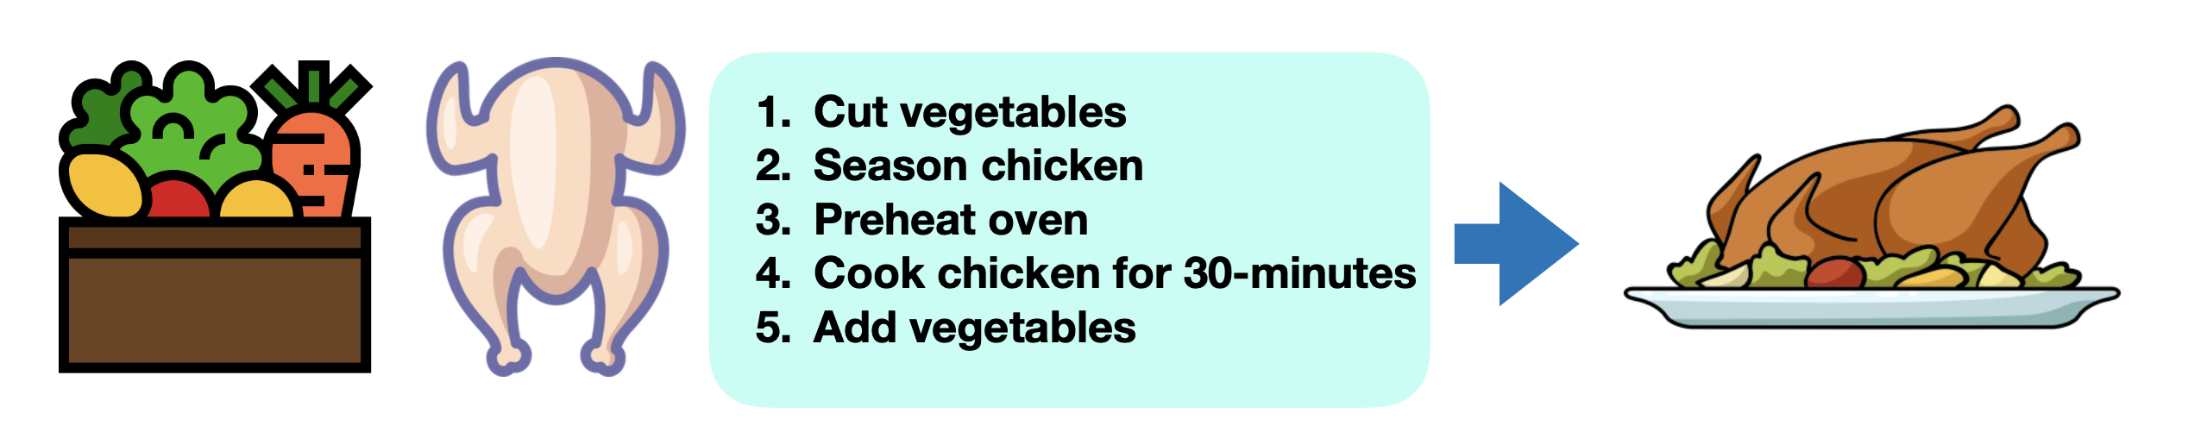
When shouldn’t you use ML
Will a simple hand-coded instruction based system work?

Slide 9
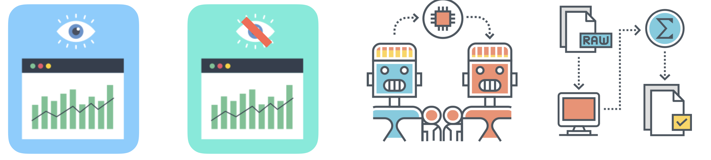
Main types of ML
Supervised
Learning
Unsupervised
Learning
Transfer
Learning
Reinforcement
Learning

Slide 10
Supervised Learning

Slide 11
Example: Supervised Learning

Slide 12
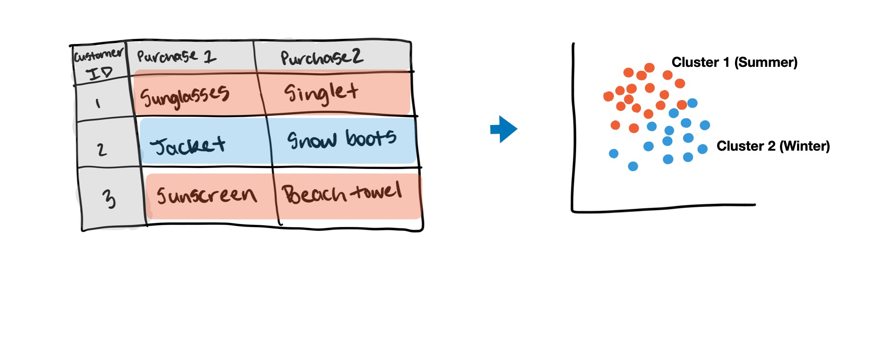
Unsupervised Learning

Slide 13
Transfer Learning

Slide 14
Reinforcement learning

Slide 15
Matching your problem

Slide 16
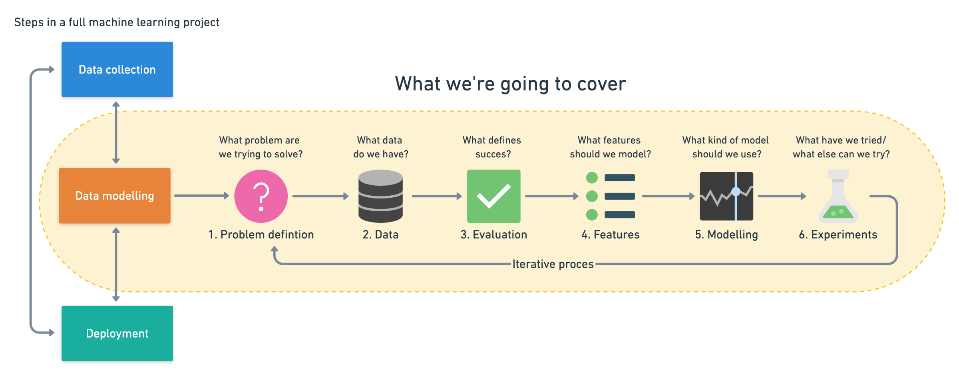
Framework
Source:https://www.mrdbourke.com/a-6-step-field-guide-for-building-machine-learning-projects/

Slide 17
Modeling 3 parts

Slide 18
The most important concept in ML

Slide 19
Supervised learning algorithms

Slide 20
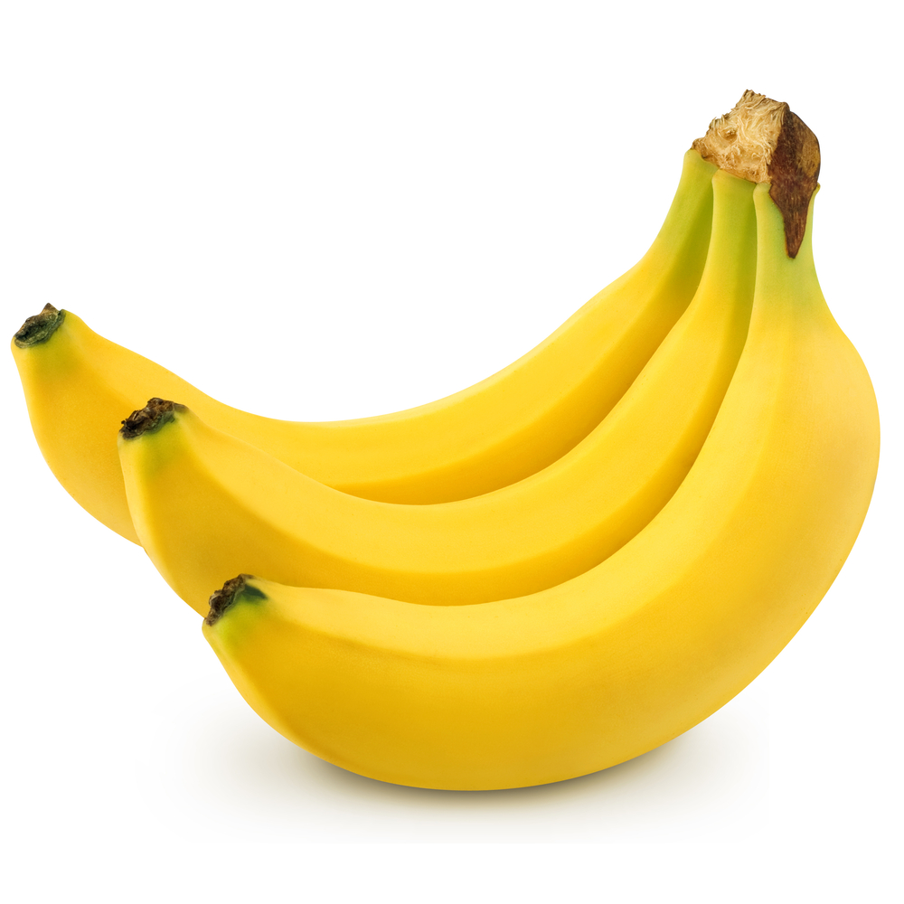
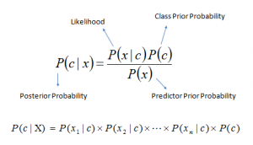
Naïve Bayes
First of all its a classification algorithm!
a fruit may be considered to be an Benana
if it is yellow, long, slender shape. Even if these features depend on each other or upon the existence of the other features, all of these properties independently contribute to the probability that this fruit is an benana and that is why it is known as ‘Naive’.

Slide 21
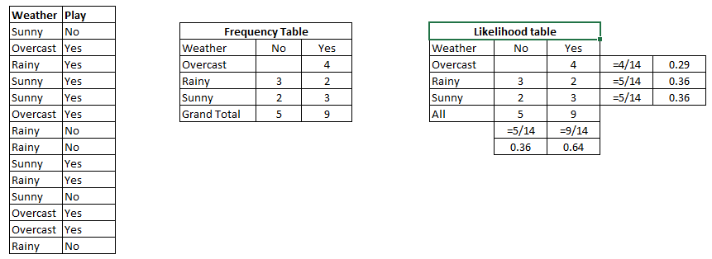
Naïve Bayes, Example
P(Yes | Sunny) = P( Sunny | Yes) * P(Yes) / P (Sunny)
we have
P (Sunny |Yes) = 3/9 = 0.33, P(Sunny) = 5/14 = 0.36, P( Yes)= 9/14 = 0.64
Now, P (Yes | Sunny) = 0.33 * 0.64 / 0.36 = 0.60, which has higher probability.

Slide 22
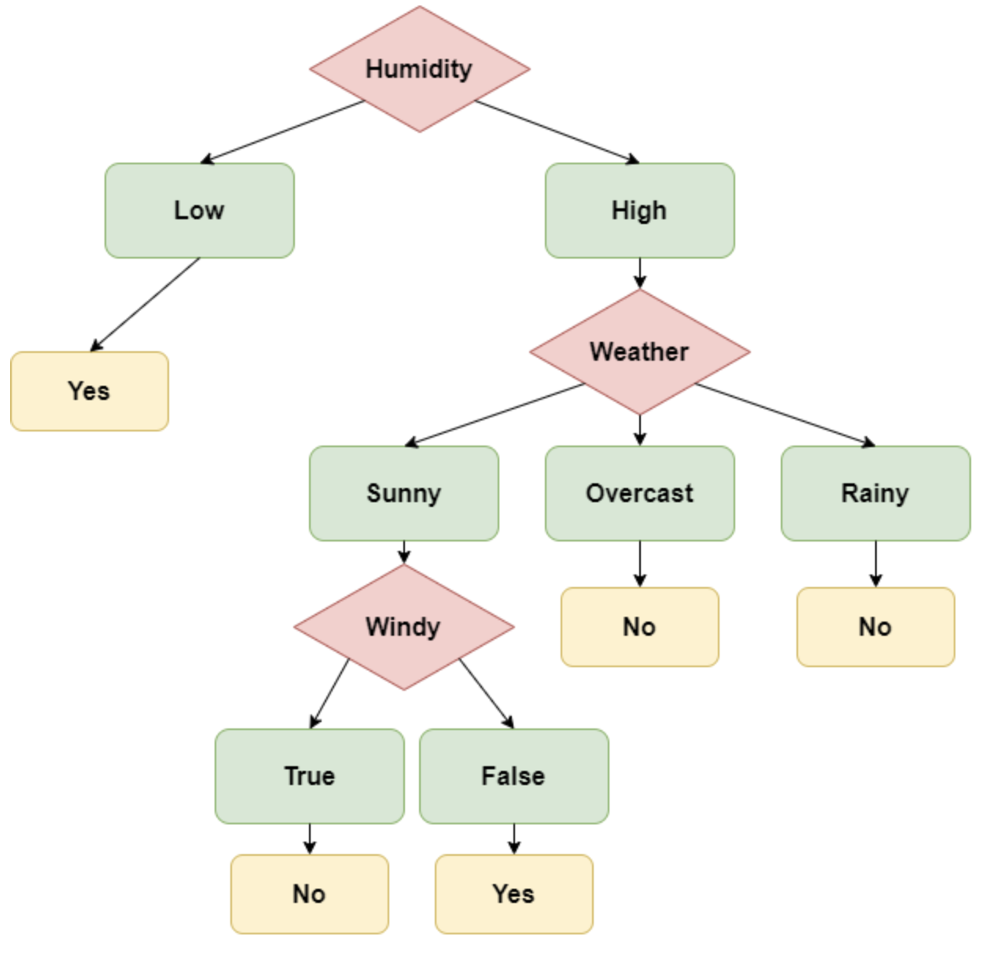
Naïve Bayes, Cons
Bayesian posening: Someone subtage the data by adding many rainy yes rows !
Solution: Decision Trees
A decision tree is formed by a collection of value checks on each feature

Slide 23
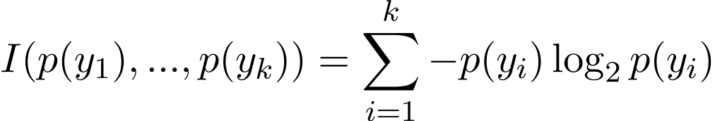
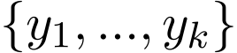
Decision Tree
How do we decide how the tree splits into branches and which features are used at each level?
To use the features in descending order of importance → Informational content
possible feature values
The information we get when the value is revealed
associated probabilities
when a feature’s values divide the data entries into approximately equal groups, then the informational content is higher, and the feature should be used early in the tree

Slide 24
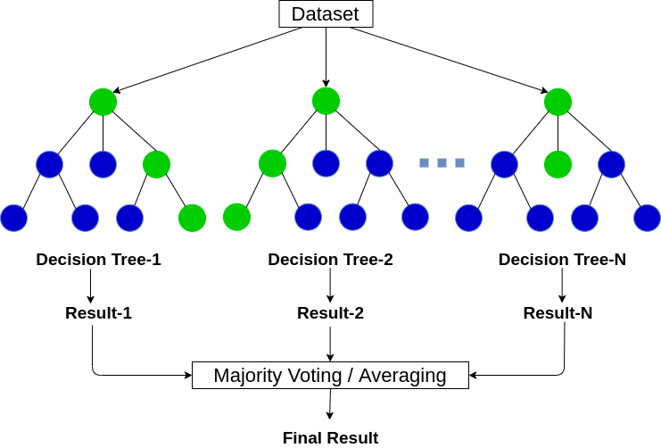
Decision Tree
The famous ones are C4.5 and CART
The tend to overfit (low bias and high variance)
Splitting is linearly
That is why random forests are using more often than trees.
It is and ensemble method
Random forests generally outperform decision trees,
but their accuracy is lower than gradient boosted trees

Slide 25
Bias-variance
Bias: How close the model can map input to output
Notes:
Bias: the strength of the assumption of the model about the functional form of the mapping between inputs and outputs.

